Slide 1
19CSE431
DIGITAL IMAGE PROCESSING
POTHOLE DETECTION USING IMAGE PROCESSING TECHNIQUES
REVIEW - 3
AVANTIKA BALAJI - CB.EN.U4CSE20309
CHARITHA UPPALAPATI - CB.EN.U4CSE20311
KAUSALYAA SRI - CB.EN.U4CSE20326

Slide 2
MORPHOLOGICAL IMAGE PROCESSING
Morphological image processing is a technique used to modify the shape and size of structures in an image. It is a non-linear image processing technique that is based on the shape of the objects in an image, rather than their intensity values. Morphological image processing is typically used to extract specific features or objects from an image, such as lines, edges, or text. It can also be used to fill in gaps or to remove noise or other undesirable features from an image.

Slide 3
MORPHOLOGICAL IMAGE PROCESSING
Morphological techniques probe an image with a small shape or template called a structuring element. The structuring element is positioned at all possible locations in the image and it is compared with the corresponding neighbourhood of pixels. Some operations test whether the element "fits" within the neighbourhood, while others test whether it "hits" or intersects the neighbourhood:
• The matrix dimensions specify the size of the structuring element.
• The pattern of ones and zeros specifies the shape of the structuring element.
• An origin of the structuring element is usually one of its pixels, although generally the origin can be outside the structuring element.

Slide 4
MORPHOLOGICAL IMAGE PROCESSING
Structuring elements play in morphological image processing the same role as convolution kernels in linear image filtering.
There are several basic morphological operations that are commonly used in image processing, including erosion, dilation, opening, and closing. Erosion and dilation are used to modify the size of objects in an image, while opening and closing are used to remove small isolated pixels or fill in gaps between objects. Top-hat and black-hat transforms are operations used in morphology and digital image processing to extract small elements and details from given images.

Slide 5
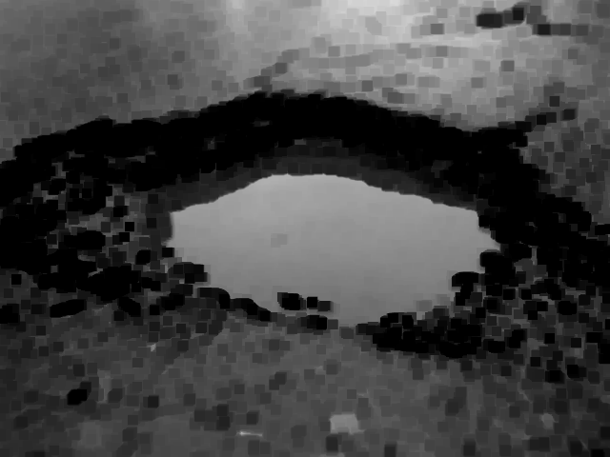
MORPHOLOGICAL IMAGE PROCESSING
1. Erosion:
Erosion is an operation that removes pixels from the boundaries of objects in an image. It is typically used to reduce the size of objects or to remove small, isolated pixels that may be present due to noise or other factors. Erosion is often used in combination with dilation to improve the performance of image analysis and object recognition algorithms.

Slide 6
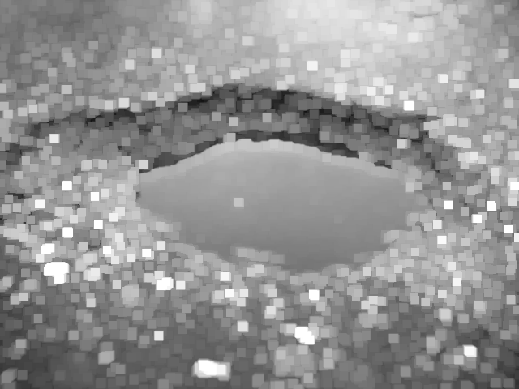
MORPHOLOGICAL IMAGE PROCESSING
2. Dilation:
Dilation is the opposite of erosion and is used to add pixels to the boundaries of objects in an image. It is typically used to increase the size of objects or to fill in gaps between objects. Like erosion, dilation is often used in combination with other techniques to improve the performance of image analysis algorithms.

Slide 7
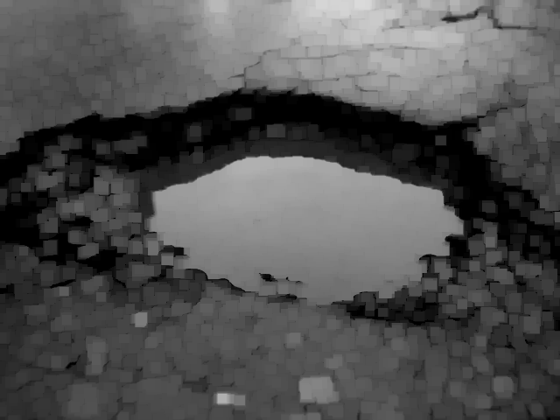
MORPHOLOGICAL IMAGE PROCESSING
3. Opening:
Opening removes small objects from the foreground (usually taken as the bright pixels) of an image, placing them in the background. Opening is similar to erosion as it tends to remove the bright foreground pixels from the edges of regions of foreground pixels. Opening operation is used for removing internal noise in an image. Opening is erosion operation followed by dilation operation.

Slide 8
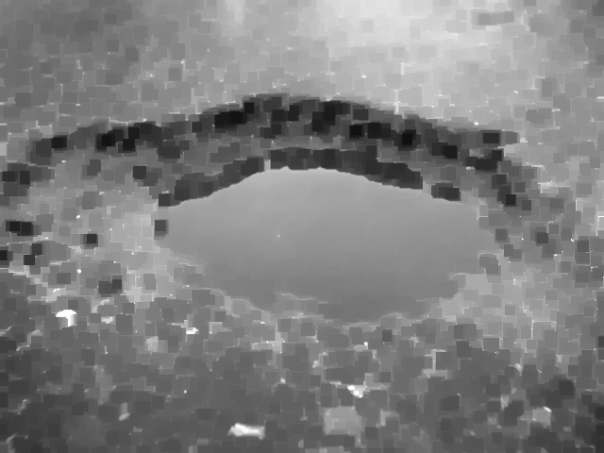
MORPHOLOGICAL IMAGE PROCESSING
4. Closing:
On the other hand it removes small holes in the foreground, changing small islands of background into foreground. It is defined simply as a dilation followed by an erosion using the same structuring element used in the opening operation.

Slide 9
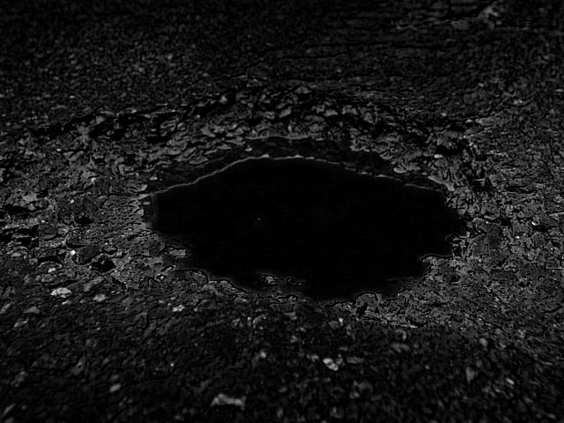
MORPHOLOGICAL IMAGE PROCESSING
5. Top Hat Filter:
It is defined as the difference between the input image and its opening by some structuring element. The top-hat filter is used to highlight bright objects against a dark background.

Slide 10
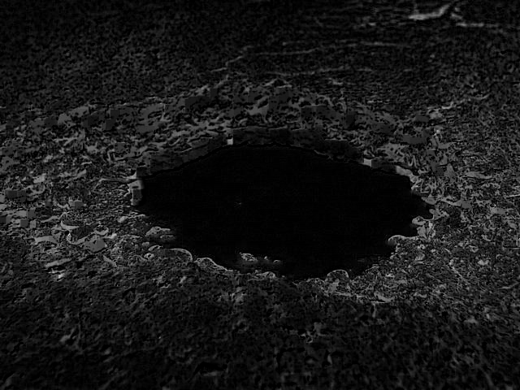
MORPHOLOGICAL IMAGE PROCESSING
6. Black Hat Filter:
It is defined as the difference between the closing and the input image. These transforms are used in a variety of image processing tasks, including feature extraction, background equalisation, image enhancement, and so on. The black-hat operation is used to enhance dark objects of interest against a bright background.

Slide 11
EDGE DETECTORS
1. CANNY EDGE DETECTOR
It is a multi-stage algorithm with steps involved:
1. Removal of noise in input image using a Gaussian filter.
2. To find intensity gradient of the image - Compute the derivative of Gaussian filter
3. Suppress the non-max edge contributor pixel points. This way we remove unwanted pixels which is not a part of the edge
4. Use Hysteresis Thresholding method to determine the true edges in the image.

Slide 12
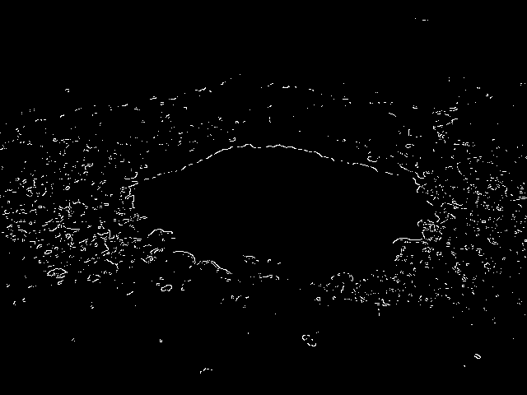
EDGE DETECTORS
The pothole can be easily distinguished from the background because the optimal detector eliminates the possibility of false positives and false negatives. There is also the advantage of good localisation: the detected edges are as close to true edges as possible.

Slide 13
EDGE DETECTORS
2. SOBEL EDGE DETECTOR
For edge detection, we use matrix to calculate areas of different intensities of an image. And wherever we find extreme differences in the intensities of the pixel, it means we have found the edge of an object. Here the image is processed separately in X and Y directions first, then the sum of the X and Y edges are taken which forms the combined output image. This works best when we first convert the image from RGB to standardised Grayscale since the Luminance plane of grayscale has far more important and distinct edge information.

Slide 14
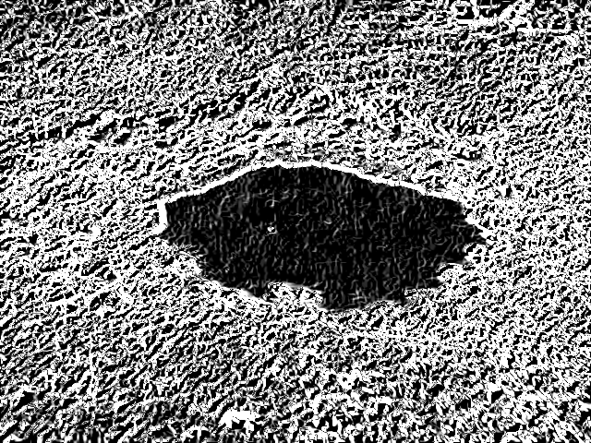
EDGE DETECTORS
SOBEL EDGE DETECTOR
Then we do kernel convolution using a 3x3 matrix. So we basically run a 3x3 matrix kernel over all the pixels in the image. At every iteration, we measure the change in the gradient of the pixels that fall within this 3x3 kernel. The greater the change in pixel intensity, the more significant the edge there is.

Slide 15
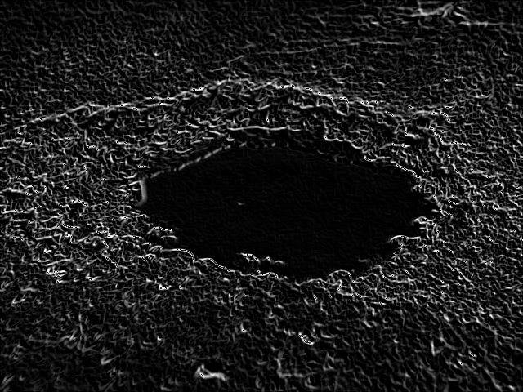
EDGE DETECTORS
3. PREWITT EDGE DETECTOR
Prewitt mask is a first-order derivative mask. This also works along the X and Y-axis separately. Wherever there is a sudden change in pixel intensities, an edge is detected by the mask. This edge can be calculated by using differentiation. The edge is represented by the local maxima or local minima.

Slide 16

EDGE DETECTORS
4. ROBERT EDGE DETECTOR
It thus highlights regions of high spatial frequency which often correspond to edges. As a differential operator, which approximates the gradient of an image through discrete differentiation which is achieved by computing the sum of the squares of the differences between diagonally adjacent pixels

Slide 17
EDGE DETECTORS
5. LAPLACIAN OF GAUSSIAN - MARR- HILDRETH EDGE DETECTOR
In Marr-Hildreth we first, we use a Gaussian filter on the noisy image to smoothen it instead of just simple averaging and then subsequently use the Laplacian filter for edge detection. The image is first filtered with the Laplacian of the Gaussian filter matrix, which is computed using the standard deviation value input for Marr-Hildreth edge detection.

Slide 18
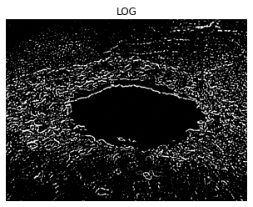
EDGE DETECTORS
LAPLACIAN OF GAUSSIAN - MARR- HILDRETH EDGE DETECTOR
The standard deviation value determines the filter matrix width and controls the amount of smoothing produced by the Gaussian component. The Gaussian filtering's Laplacian will smooth the image and enhance the edges. Edge localization is performed after filtering by locating zero crossings at each pixel in all directions.

Slide 19
IMAGE SEGMENTATION
The process of dividing an image into multiple segments or regions, each of which corresponds to a different object or background in the image, is known as image segmentation. The goal of image segmentation is to simplify and/or change an image's representation into something more meaningful and understandable.
Image segmentation can be accomplished using a variety of techniques such as:
• Threshold Based Segmentation • Edge Based Segmentation
• Region-Based Segmentation
• Clustering Based Segmentation • Artificial Neural Network Based
Segmentation

Slide 20
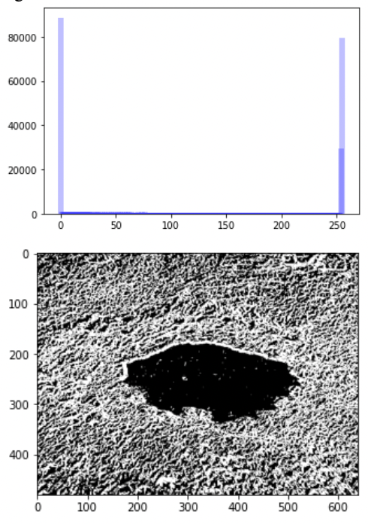
IMAGE SEGMENTATION
1. Thresholding Techniques:
There are several thresholding techniques:
Global thresholding: We use a bimodal image in this method. A bimodal image is one with two intensity peaks in the intensity distribution plot. One is for the object, and the other is for the background. Then we calculate the global threshold for the entire image and apply it to the entire image.
Optimal Thresholding: Optimal thresholding technique can be used to minimize the misclassification of pixels performed by segmentation.

Slide 21
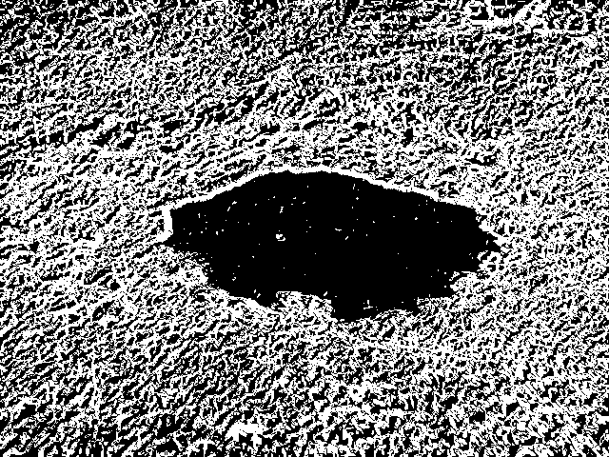
IMAGE SEGMENTATION
One of the ways to achieve an optimal threshold is Otsu's method. In this method, we find the spread of foreground and background of the pictures for all possible values of threshold. The threshold with the least spread is taken as the optimal threshold
1. Otsu's algorithm
The algorithm iteratively searches for the threshold that minimizes the within-class variance, defined as a weighted sum of variances of the two classes (background and foreground). The colors in grayscale are usually between 0-255 (0-1 in case of float). So, If we choose a threshold of 100, then all the pixels with values less than 100(black) becomes the background and all pixels with values greater than or equal to 100 becomes the foreground of the image(white)

Slide 22
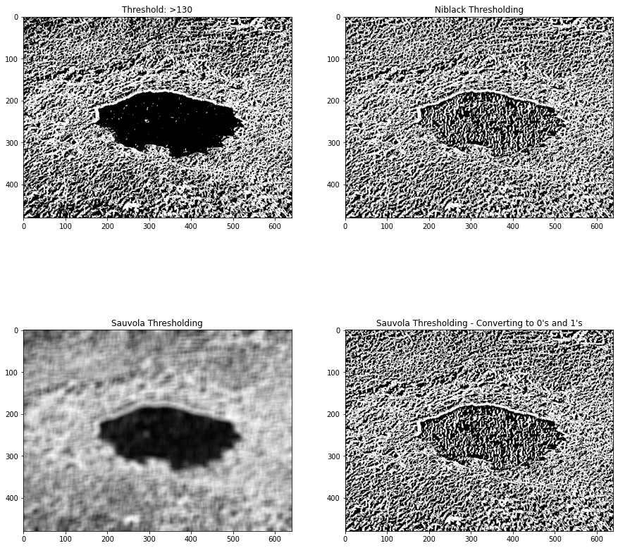
IMAGE SEGMENTATION
2. Niblack and Sauvola thresholding
Niblack and Sauvola thresholds are local thresholding techniques that are useful for images where the background is not uniform, especially for text recognition 1, 2. Instead of calculating a single global threshold for the entire image, several thresholds are calculated for every pixel by using specific formulae that take into account the mean and standard deviation of the local neighborhood (defined by a window centered around the pixel).

Slide 23
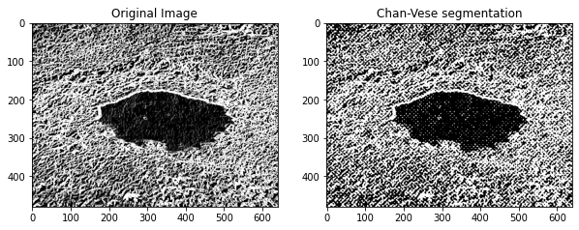
IMAGE SEGMENTATION
3. Chan-Vese Segmentation Algorithm
The Chan-Vese segmentation algorithm is designed to segment objects without clearly defined boundaries. This algorithm is based on level sets that are evolved iteratively to minimize an energy, which is defined by weighted values corresponding to the sum of differences intensity from the average value outside the segmented region, the sum of differences from the average value inside the segmented region, and a term which is dependent on the length of the boundary of the segmented region.

Slide 24
EVALUATION METRICS
We have evaluated our algorithms and filters using two of the following evaluation metrics:
1. PSNR Ratio - The PSNR block computes the peak signal-to-noise ratio, in decibels, between two images. This ratio is used as a quality measurement between the original and a compressed image. The higher the PSNR, the better the quality of the compressed, or reconstructed image.
2. SSIM Index - The Structural Similarity Index (SSIM) is a perceptual metric that quantifies image quality degradation caused by data compression or transmission losses. It is a full reference metric that necessitates the use of two images from the same image capture—a reference image and a processed image.

Slide 25
RESULTS AND CONCLUSION
Robert edge detector gives us a better similarity index of 0.0921 and a clear demarcation of the edges compared to the other edge detectors. However the PSNR of Canny edge detector is the best for filtering the edges with a value of 27.948. We observe that Sauvola thresholding produces a much better SSIM value of indicating a more structurally segmented image with a higher similarity to a pothole.
This can be combined with machine learning models used for classification such as decision tree, SVM, logistic regression in order to extract features from the frequency domain.

Slide 26
REFERENCES
[1] Ministry of Road Transport and Highways (MoRTH) data - https://www.ndtv.com/india-news/ over-5-000-killed-in-road-accidents-caused-by- potholes-in-2018-20-transport-ministry-3276432
[2] The political economy of India’s potholes, The New Indian Express, September 2022 https://www.newindianexpress.com/opinions/2022/ sep/25/the-political-economy-of- indiaspotholes-2501582.html#:~:text=Such%20is% 20the%20persistence%20of,was%20over%20Rs%2 01500%20crore
[3] An Automated Machine-Learning Approach for Road Pothole Detection Using Smartphone Sensor Data, Article by Chao Wu; Published: 28 September 2020
[4] https://towardsdatascience.com/image- segmentation-part-1-9f3db1ac1c50
[5] https://www.cs.auckland.ac.nz/courses/ compsci773s1c/lectures/ImageProcessing-html/ topic4.htm

Slide 27
Thank You

